Slide 1
Risk Constrained Short Term Electricity Procurement for Open Access Consumer in India
Abstract
Introduction
Short Term Trading in Indian scenario
Problem Description & Formulation
Case Study and Results
Conclusion

Slide 2
Abstract
Open access (OA) is a major power sector reform
Encourages short term trading for meeting variations in demand
OA large consumer can participate in short term trading through
1. Bilateral contracts
2. Power exchanges (PXs) or
3. Unscheduled interchange (UI) transactions
Need to satisfy obligations of Renewable Purchase Obligation (RPO)
Uncertainties in Indian Power Sector (considering OA) taken as CONSTRAINTS
Prices of PX’s Day Ahead Market (DAM) (evaluated from auctions based on demand supply bids)
UI charges for frequency variations (due to real time deviations in withdrawals thus fluctuating grid frequency)
RPO mandates
Objective
Optimal short term power procurement strategy for large OA consumer from available trading options.

Slide 3
Introduction
Considerations
Small self generation facility
Demand flexibility
Practical case study of Indian OA consumer
Power sector reforms → bulk electricity trading & introduction to open access
Short term trading → electricity providers and bulk power consumers balance their fluctuating power demands
Requires effective planning by market participants for efficient functioning
Short term trading contracts include
1. Electricity transactions performed over periods less than a year (through bilateral contracts)
2. Power Exchanges (PXs) and
3. Unscheduled Interchange (UI)
Term Ahead Market (TAM) and Day Ahead Market (DAM) are executed through PXs
There is no balancing market in India, and real-time balancing takes place through UI

Slide 4
UI → charges imposed for deviating from the scheduled withdrawal or injections
Share of Short Term Electricity Procurement (STEP)
OA is limited to bulk power consumers in India connected to HV network
OA consumers → specified percentage of their demand from renewable sources (RPO fulfillment by Feed in Tariff (FIT) or Renewable Energy Certificates (RECs)
Face volatility in prices both in DAM & UI
Risk of cost variation
Efficient trading plan addresses these risks
Optimal short term power procurement strategy from available options, for a future time period, under the uncertainties of UI charges and DAM prices
Consumer is an obligated entity to fulfill RPO.
Balances flexible demand from UI to minimize penalty
Overall problem is of cost minimization
Uncertainties are addressed with variance
8 % in 2008-09 | 11 % in 2013-14

Slide 5
Short Term Trading in Indian Scenario
Consumer has minimum cost opportunities with short term trading.
OA consumer can procure its short term fluctuating demand by participating and bidding in the market, instead of contracting through aggregators
Aggregators offer large scale demand aggregation (long term PPA)
Power Exchange Transactions
Trading takes place for physical delivery and no financial contracts exist
Majority transactions occur through long term PPAs
Short term trading balances short term needs of utilities
Contracts with definite expiry period can be traded on a weekly, monthly or yearly basis in advance through PXs.
TAM transactions are for physical delivery of electricity for more than one day
DAM transactions are traded through double sided anonymous auction bidding process
Demand supply forces decide the prices
Intra-day or contingency contracts are traded for utilizing residual capacity after DAM

Slide 6
UI Mechanism
India is generation deficit country with wide fluctuation in grid frequency
A penalty based mechanism was introduced in 2002
Present frequency band is 49.7-50.05 Hz (49.9-50.05 Hz)
Participants, deviating from scheduled generation or withdrawal when frequency is beyond the prescribed frequency band, are penalized
UI rate increases linearly for frequency below 50 Hz
The deviations are determined in 15-minute time blocks
Over withdrawal during times of low grid frequency results in penalty
Under withdrawal supporting low grid frequency, results in revenue earning
Deviation Settlement Mechanism (DSM) Regulations 2014
Additional UI charges for a market participating consumer who withdraws over 12 % of its scheduled demand or 150 MW
For under withdrawal over 12 % or 150 MW, UI charges are zero (to discourage using UI for revenue earning)

Slide 7
Trading Under RPO
RPO obligations to purchase a fixed percentage of its annual demand from renewable energy sources
FIT contracts or by trading of RECs
REC is a market based instrument traded through closed double sided auction in PXs within the forbearance and floor price once in a month
One REC is quantified as 1 MWh of electricity injected into the grid from renewable energy sources
FIT contracts with the designated renewable energy generators
FIT is a long term PPA with a preferential tariff decided by state regulators for RE fed to grid

Slide 8
Problem Description
OA large consumer is assumed to participate in short term power trading through bilateral contracts and DAM or spot market to procure its known demand at minimum cost.
It has a self generation unit of small size and has to satisfy RPO for the considered planning period T, by entering into either FIT contracts or REC purchase
Flexible demand (can shifted by altering demand pattern of consumer)
DAM prices and UI charges are considered uncertain and modeled through variance
Overall problem for the large consumer is of cost minimization while managing the risk of UI charges and DAM prices
Historical data has been taken to model uncertainty in UI rates and DAM prices
Policy changes have been neglected

Slide 9
Problem Formulation
Power procurement from bilateral contracts
Power procurement from spot market
Power procurement through FIT contracts
REC purchase
Cost of self generation
UI charge
Cost modelling
Risk modelling
Demand modelling
RPO modelling
Objective Function (OF)

Slide 10
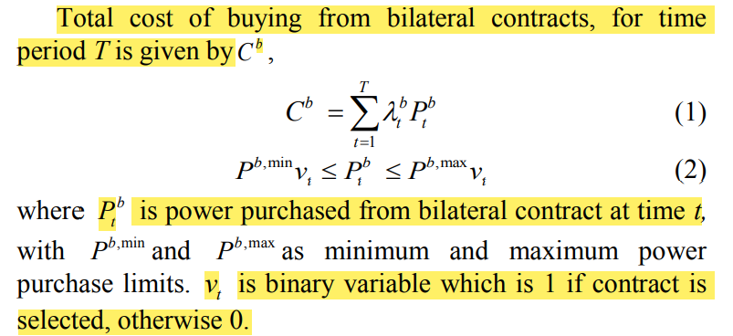
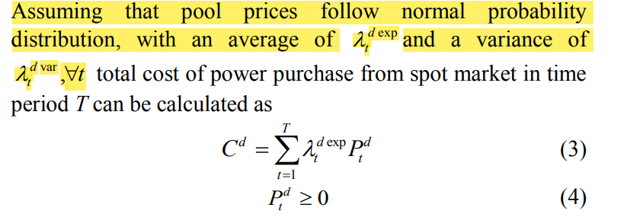
Power procurement from bilateral contracts
Power procurement from spot market

Slide 11
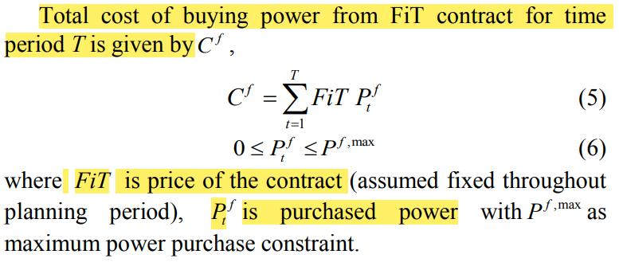
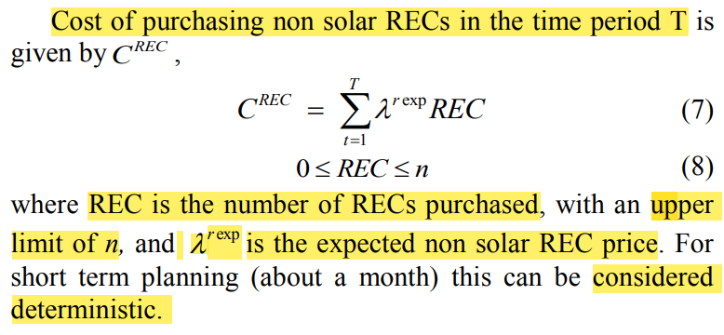
Power procurement through FIT contracts
REC purchase

Slide 12
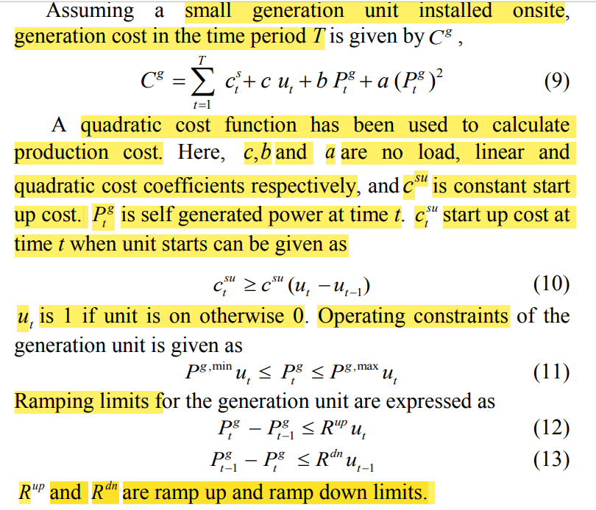
Cost of self generation

Slide 13
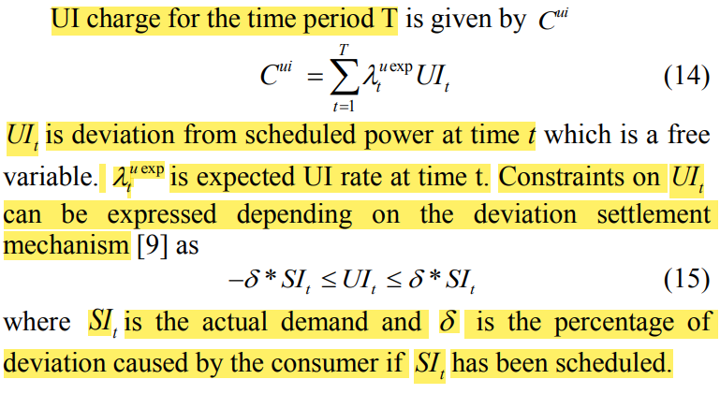
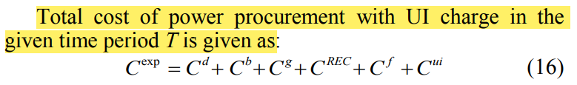
UI charge
Cost modelling

Slide 14
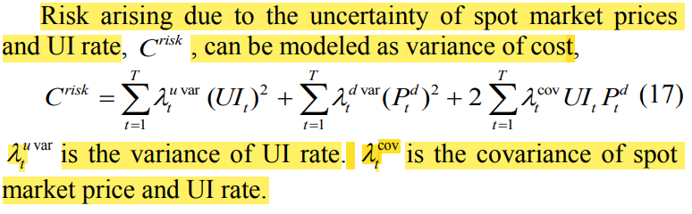
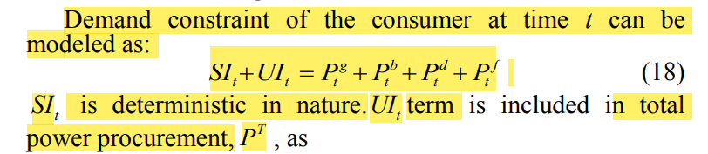
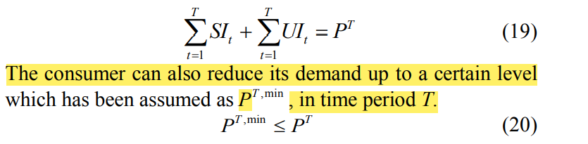
Risk modelling
Demand modelling

Slide 15
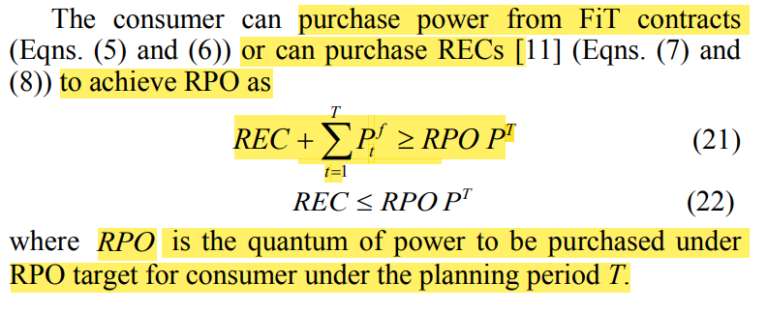
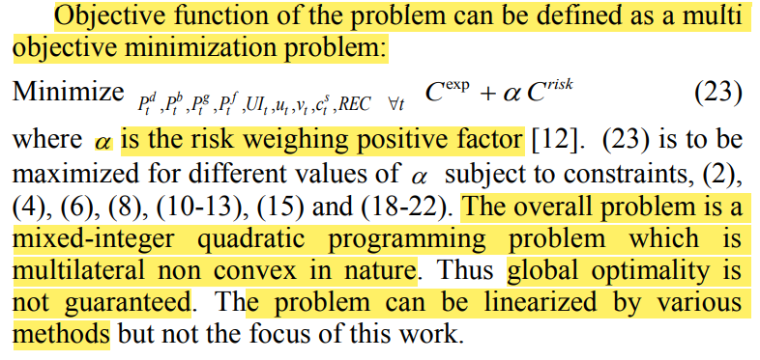
RPO modelling
Objective Function (OF)

Slide 16
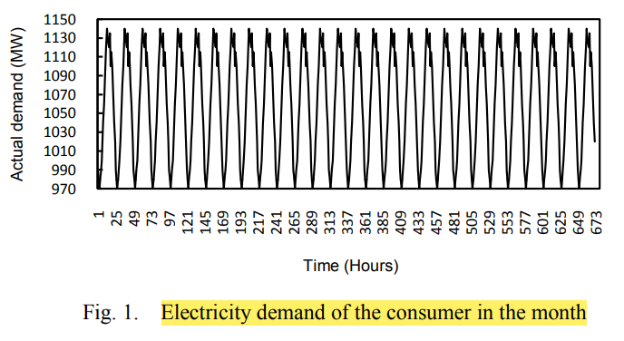
Case Study and Results
OA large consumer in western regional grid of India
Plans withdrawal schedule for a month from
1. DAM
2. One bilateral contract
3. FIT and
4. Self generation unit
12% demand flexibility is considered for real time balancing
Each hour is a trading interval, total trading intervals for the month are 672
Minimum monthly demand limit is 660000 MWh
Data for bilateral contract
Period | Price (Rs./MW) | Min. Volume (MW) | Max. Volume (MW)
I week | 2600 | 30 | 600
II week | 2800 | 30 | 600
III week | 3000 | 30 | 600
IV week | 2900 | 30 | 600

Slide 17
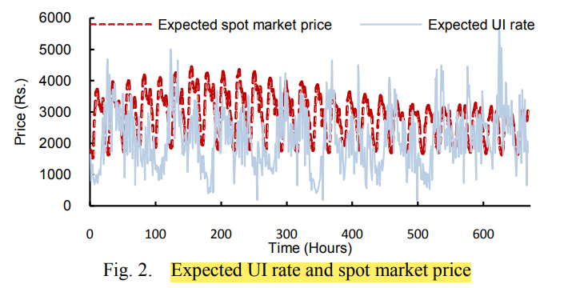
FIT | Rs. 5000/MW
Maximum limit for FIT | 700 MW
RPO | 10%
Expected values of spot market price | Mean of five year (2011- 2015) values from the Indian Energy Exchange (IEX)
Expected UI rate | UI summary data taken from Western RLDC website
Non solar REC price | Rs. 1890 (considering last 5 years for the same month)
Maximum number of RECs | 50000
Data for self generation unit
Capacity | 120 MW
Minimum Power output | 20 MW
Ramping Limit (up/down) | 80 MW
Quadratic cost | Rs. 0.6/(MW)²h
Linear cost | Rs. 2700/MWh
No-load cost | Rs. 2000
Startup cost | Rs. 1000

Slide 18
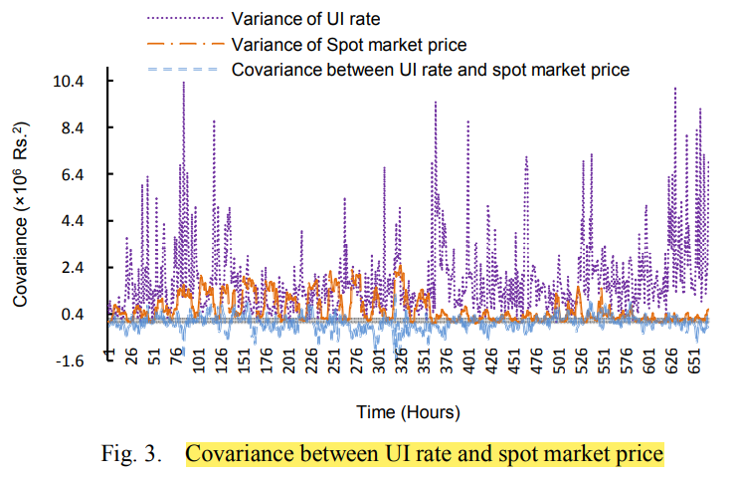
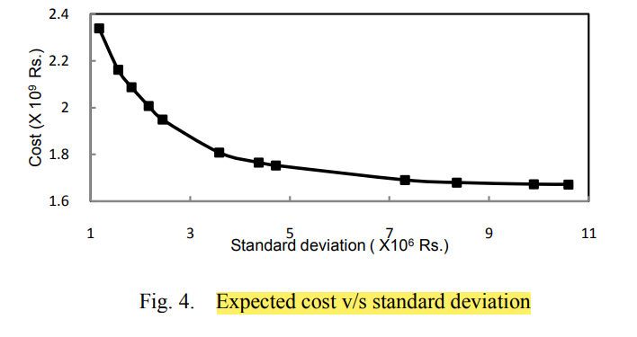
To find the optimum decision, objective function (23) is to be minimized with the constraints in equations (2), (4), (6), (8), (10-13), (15), and (18-22).
Standard deviation of net cost is the square root of cost variance
Expected cost increases as its standard deviation decreases
Risky procurement requires less investment
Avg. SD for UI rate | Rs.1255.349/MWh
Avg. SD for spot market price | Rs.692.4845/MWh

Slide 19
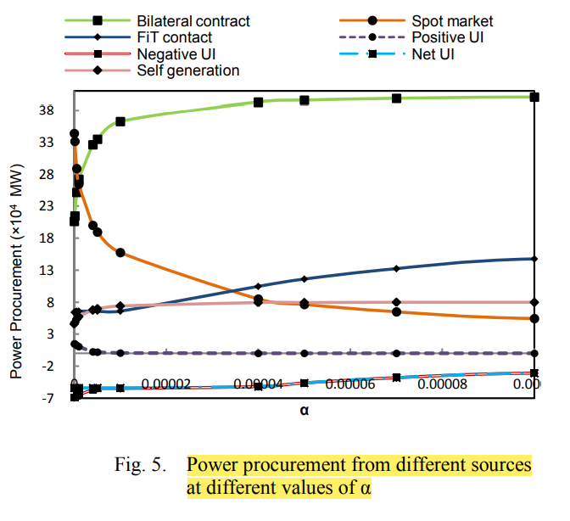
Both values of UI are decreasing from α = 0 to higher values of α but positive values of UI become zero at α = 0.00004
UI net is same till α = 0.00004 and starts decreasing afterwards
This is due to lower values of α that makes more procurement from risky spot market and constant FIT procurement
So value of UI is more than other options resulting in less investment
As FIT procurement is less more RECs are bought for satisfying RPO constraint
When α increases beyond α = 0.00004, risky behavior decreases exponentially and so power procurement from other sources increase
This represents behavior of demand deviation from the actual demand, from UI, for different values of α
Positive value of UI occurs during periods of low UI rates
Negative UI suggests reducing consumption up to demand flexibility limit, in order to reduce cost

Slide 20
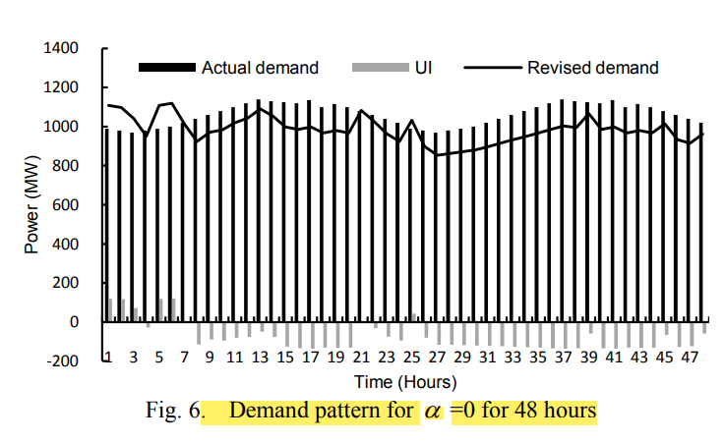
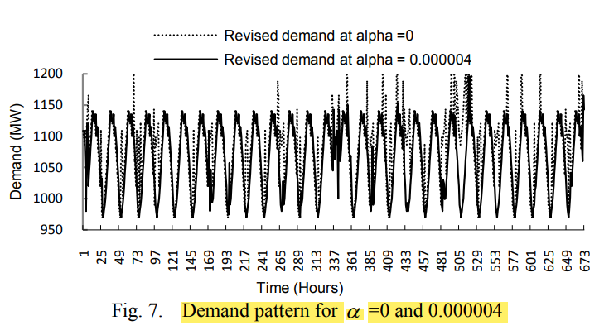
The procurement strategy suggests consumer to shift its demand from scheduled one
This helps to attain minimum cost position
Revised demand is the sum of the actual demand and unscheduled deviation (UI)
Negative UI values signify decrease in actual demand while positive UI value represents increased actual demand
Revised total monthly demand is 660000 MW up to α = 0.00004, which then increases to 698348.9 MW till α = 0.0005
Revised total monthly demand reduces with percentage reduction 2.2% (α = 0.0005) to 7.5 % (α = 0) in the actual total monthly demand

Slide 21
The increasing demand represent negative correlation between DAM and UI prices
Due to UI value, flexibility introduced in demand for the consumer varies from +2.1% to -9.7%
With the given model consumer is capable to decide its minimum cost electricity procurement strategy and monthly demand profile under uncertain grid and market scenario, while also fulfilling RPO
Conclusion
Decision making model has been designed for electricity procurement and demand planning by a large consumer for short term trading, under uncertain DAM prices and UI charges fulfilling RPO obligations.
Procurement from DAM and with positive and negative value of UI is more at lower values of risk aversion (less α-high risk), and it decreases with risk aversion (high α-low risk) thus shifting towards risk free options
The results suggest reducing consumption at real time to get minimum cost
Demand alteration is higher for high risk cases (lower risk aversion levels) and reduces for low risk cases(increasing risk aversion)
UI value has introduced notable demand flexibility for the consumer.

